Slide 1

Taming the CQRS Pattern
By Paul Walter

Slide 2
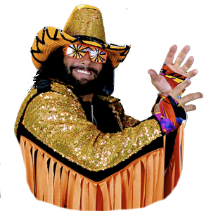
Download the Code!
Clone or download the code. Execute the migration script in “PetStore.Infrastructure/Scripts/Migrations” in your SQL Server DB.
It’s a simplified example of most of the ideas we’ve gleaned from the Microsoft eShops project.
Note, this simplified project isn’t addressing external messaging, just from within a microservice.

Slide 3
What is CQRS?
It is a software pattern that promotes separating your reads from your writes.
Promotes an event-based programming model.
Useful for microservices.
It does this for performance reasons.
Write side = complex joins
Read side = no joins (if you can)
The acronym stands for “Command and Query Responsibility Segregation.”

Slide 4
Why does CQRS have “Wilds”?
It’s COMPLEX.
New programming paradigm.
Not many well documented projects.
There’s differing opinions implementation.
Going into “the unknown” is a scary prospect.
Differing flavors of CQRS: Event Sourcing vs. Not.
Many times it’s coupled with Domain Driven Design (DDD) which also has a high learning curve.

Slide 5
Why use an Event Driven Model?
It let’s our applications respond to inner and outer events.
Inner Events = from within our Microservice.
Outer Events = msgs from other Microservices
Using a Microservice Architecture, we can orchestrate transactions with other Microservices or respond to events within our system.

Slide 6
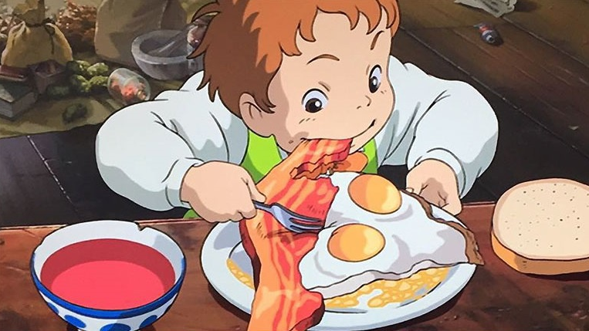
Now…a story about Food
Before we discuss
CQRS more, let’s
look at a parallel
story we all know…

Slide 7

First…a story about Food
…which takes place in a restaurant
(You know
this story,
yeah?)
Before we discuss CQRS, let’s look at a parallel story.

Slide 8

So…The Client consults the Menu… and the Waiter creates the order
(The client is the domain expert on what will be delicious for them)

Slide 9

Cook receives the order
(Check them out in the top right. Those Orders are hanging out in a queue.)

Slide 10
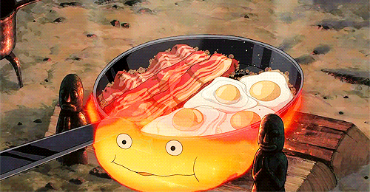
…AND PREPARES THE MEAL
(nom nom nom)

Slide 11
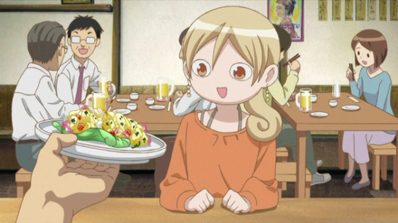
Waiter serves the meal
And
Creates
A bill

Slide 12

Client eats their meal!
And is delighted!

Slide 13
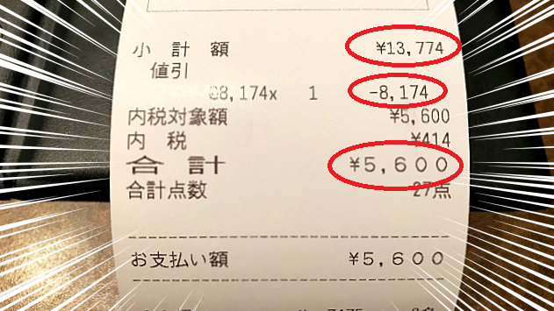

Client Consults their bill
(Hopefully, there isn’t any Japanese profanity on this)

Slide 14
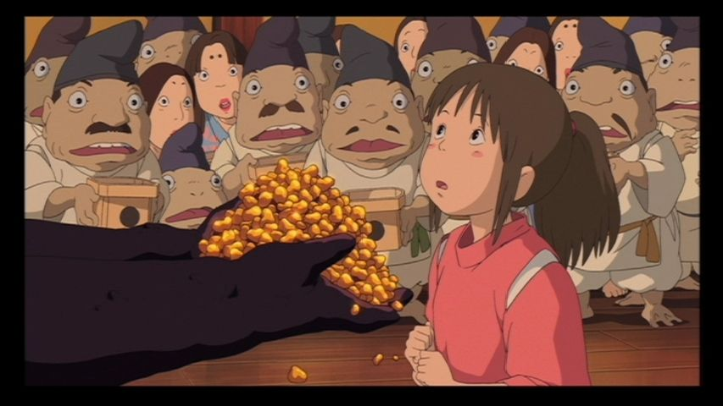
Lastly… Client Pays their Bill

Slide 15
The End
(See? You knew that story!)

Slide 16
CQRS
…is a similar story

Slide 17
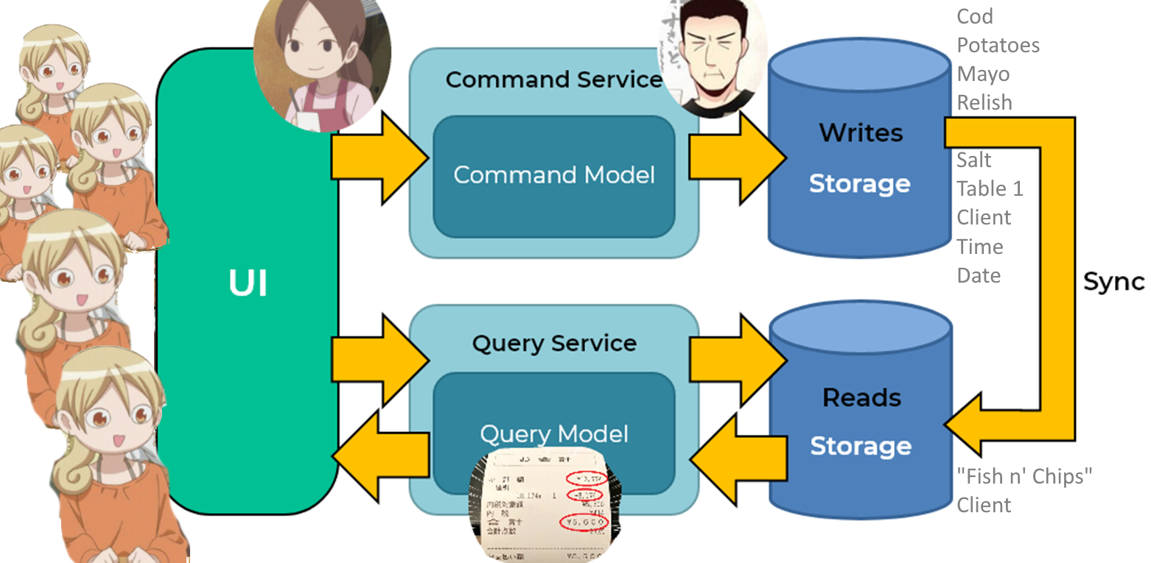

Slide 18
The “Writes”
Database has a lot of things, no?
See how
many users?
Look how little there is in the “Reads” database!!!!

Slide 19


Question 1
…how do they get what they need to do their job?

Slide 20

Autofac (IOC) (Totoro magically supplying fun)

Slide 21
Autofac
Autofac is a magic Inversion of Control Container (IOC).
IOC Container is a framework that injects dependencies through a constructor.
Uses the Dependency Inversion Principle (program to an abstraction)
Dependency Inversion Principle is part of the SOLID

Slide 22
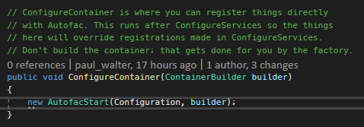
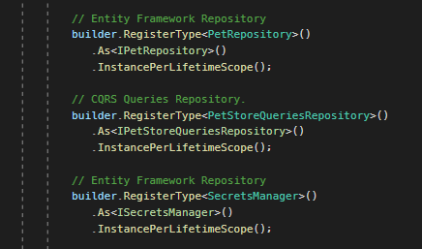
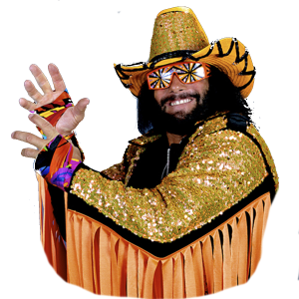
Autofac
Configuration
Startup.cs
AutofacApplicationModule.cs
See the PetStoreQueriesRepository?

Slide 23
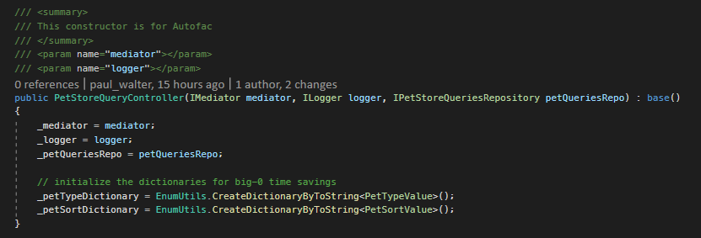
Autofac
Usage: After it’s configured, it’s magic: Just identify which dependencies you’d like, like so….see Macho Man pointing to the “IPetStoreQueriesRepository”? (Ohhhh yeah!)
PetStoreQueryController.cs

Slide 24
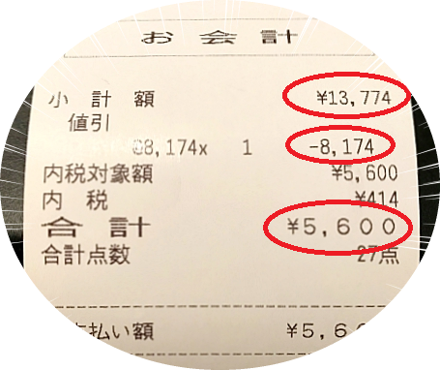
Question 2
…how do they communicate internally?
(Externally is another presentation, aka msg’ing between microservices)

Slide 25
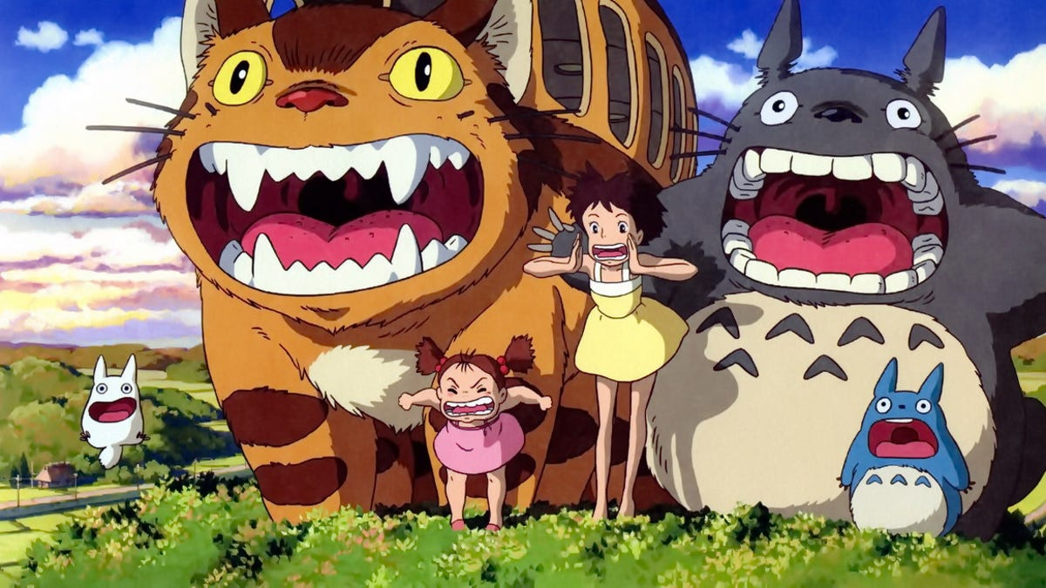
“MediatR”

Slide 26
“MediatR”
MediatR: a way to pass messages between objects.
It’s like when you have your hands full, but you can still communicate verbally to a person in another room.
It decouples our designs and makes for a cleaner set of object responsibilities.

Slide 27
“MediatR”
Main Concepts in MediatR:
Requests:
Only one handler at a time.
Can be used via Decorator Pattern to create pipelines.
Notifications:
Multiple Handlers
This is how we are dispatching our “Domain Events”.

Slide 28
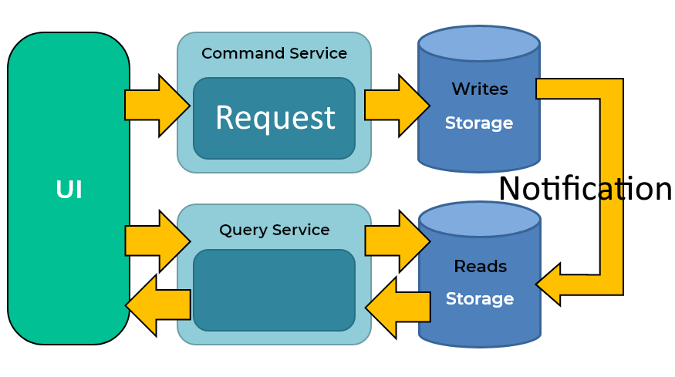
“MediatR”

Slide 29
See specifics in the Appendix below!

Slide 30
Question 3
…how do validate business rules easily?

Slide 31

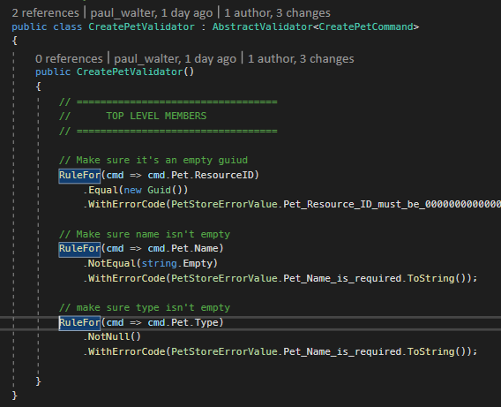
Fluent Validation
What is it?
It’s a library for writing object validations.
Why use it?
Emily and I think it’s great!
Well, that and it’s fast to ensure complex business are correct &, if not, send the correct errors.
Notice my errors…I’m referencing Error Codes defined in my Open API yaml file!
Where is it?
Check out the CreatePetValidator.cs file

Slide 32

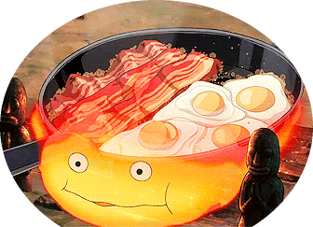
Question 4
…how do we scaffold this app?

Slide 33


OpenAPI
What is it?
It’s technology for enforcing API contracts.
Why use it?
It promotes a high level, design-first, type of thinking.
You can clearly communicate your ideas across development teams.
You can scaffold the heck outta it!!!!
Where is it?
Check out the `README.md` in the `PetStore.OpenAPI` project

Slide 34
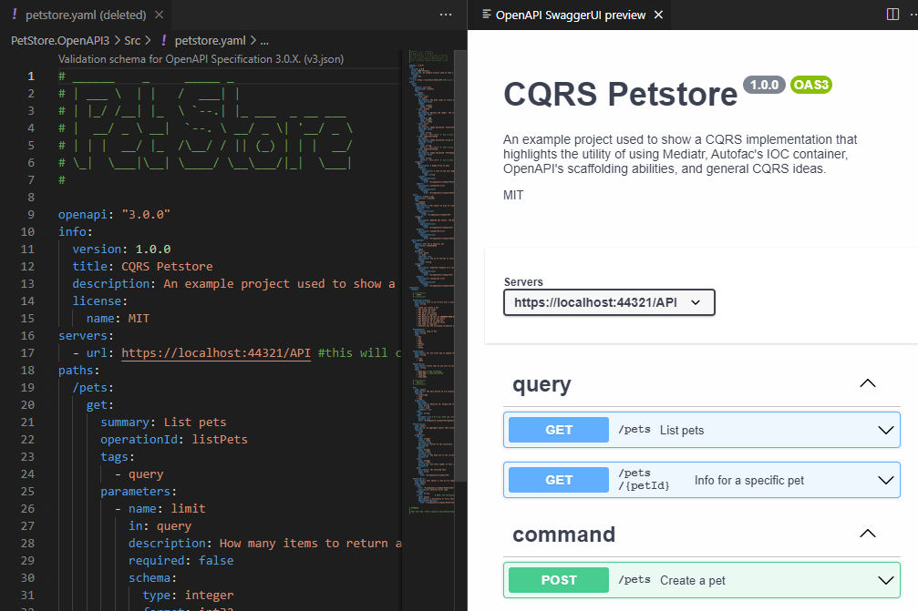
OpenAPI
Editing / Testing
I like to use VS Code to edit & test my OpenAPI files.
There are two flavors: JSON and Yaml. Yaml is easier to read imo.
There’s also a good plugin called “OpenAPI (Swagger) Editor” by
42Crunch.
You can also import OpenAPI files into Postman

Slide 35
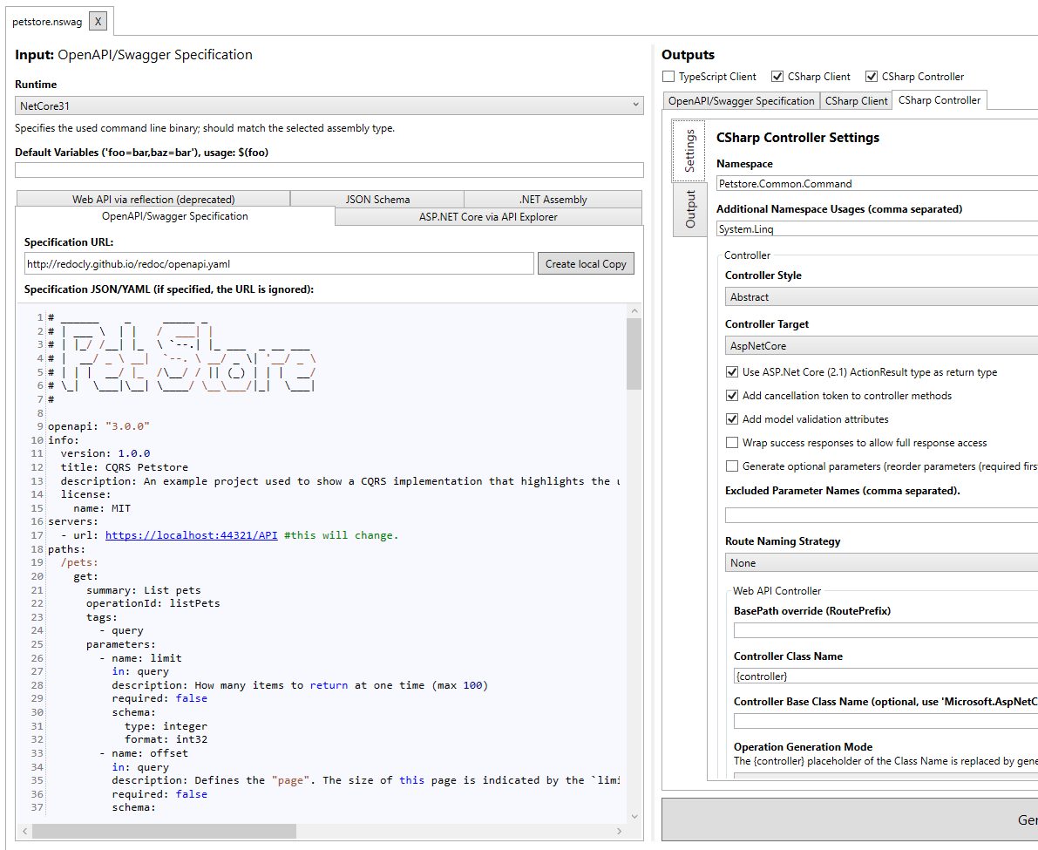
OpenAPI
Scaffolding
There are many different scaffolders depending on what computer language you are using.
For C#, Nswag is my preferred scaffolder. It uses a GUI called “Nswag Studio”.
You can scaffold C# servers, C# & JavaScript clients.
Check out the Microsoft Tutorial for more information.

Slide 36
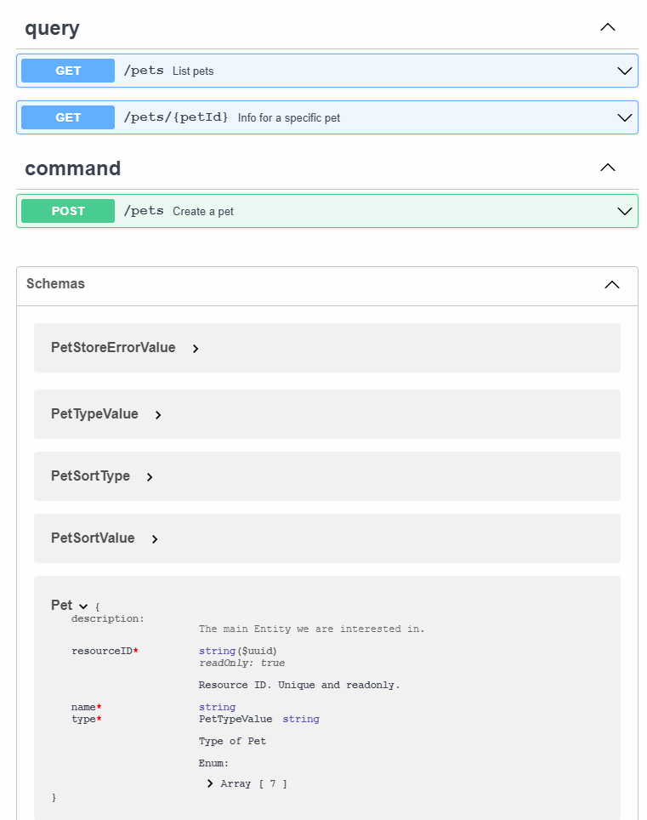
OpenAPI
Existing Code
You can also hook Nswag into your applications to create a OpenAPI document for you.
This provides great visibility on what your API is doing.
By hooking in Nswag, it can also generate a Swagger Editor view so you can inspect your endpoints AND all the objects being serialized.

Slide 37

Demo
Let’s see this bebe this in action!
(Please clone my CQRS PetStore project.)

Slide 38
Appendix
Technology
Autofac: https://autofac.org/
Fluent Validation: https://fluentvalidation.net/
Martin Fowler: https://martinfowler.com/bliki/CQRS.html
MediatR: https://github.com/jbogard/MediatR
Microsoft eShops: https://docs.microsoft.com/en-us/dotnet/architecture/cloud-native/introduce-eshoponcontainers-reference-app
Source Making (software patterns): https://sourcemaking.com/design_patterns
Assets
Shin-chan: https://en.wikipedia.org/wiki/Crayon_Shin-chan
Ghibli : https://ghiblicollection.com/
Wakako Zake: https://en.wikipedia.org/wiki/Wakakozake

Slide 39
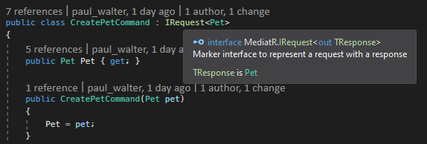
“MediatR”
Request: Create the Request Object
Notice the `IRequest` interface is of type MediatR.IRequest
CreatePetCommand.cs

Slide 40
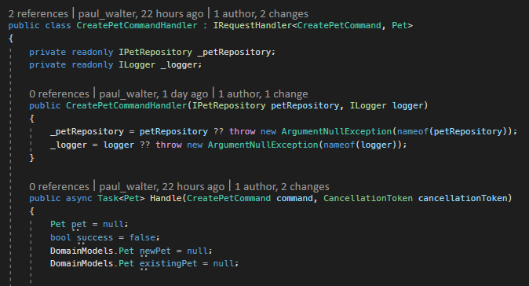
“MediatR”
Request: Create the Request Handler
CreatePetCommandHandler.cs

Slide 41
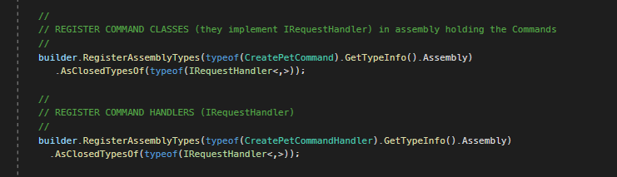
“MediatR”
Request: Configure with Autofac
AutofacMediatorModule.cs

Slide 42
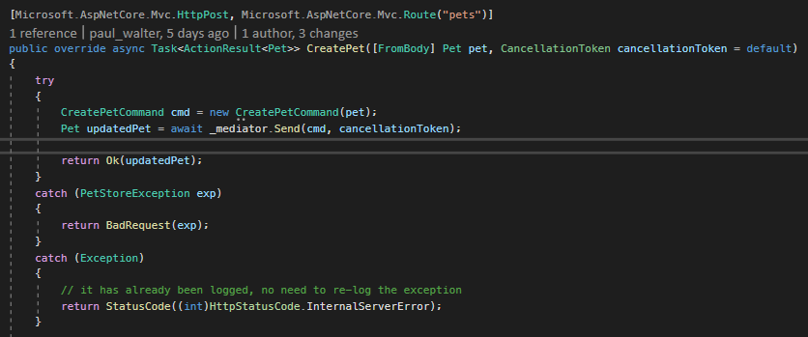
“MediatR”
Request: Dispatch
PetStoreCommandController.cs

Slide 43
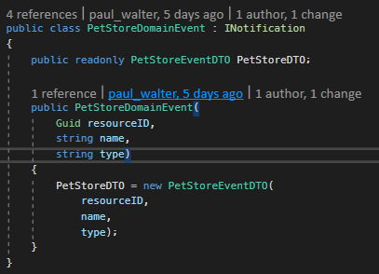
“MediatR”
Notification: Create Notification Object
Note that our Domain Events are all notifications.
In the Domain layer we add these events to a Domain object
Then, when we pass them to the Infrastructure layer, if everything goes ok, we dispatch the Domain event.
PetStoreDomainEvent.cs

Slide 44
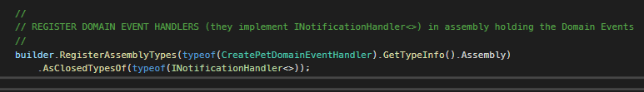
“MediatR”
Notification: Autofac Configuration
AutofacMediatorModule.cs

Slide 45
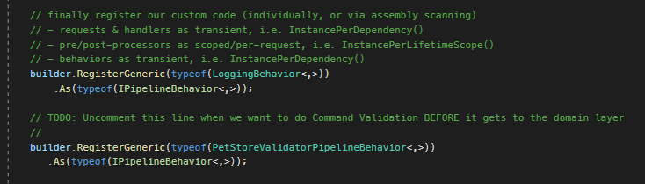
“MediatR”
Pipeline: Logging, Validations and Transactions
So in addition to Requests, you can chain them together so that every Request has to proceed through a series of handlers. In the PetStore example, I’ve got a Logging & Validation handlers set up.
See the eShops github example for more context (See Appendix)
This is how I’m configuring Autofac to wire up Logging & Validations.
AutofacStart.cs

